Slide 1
Music Recommendation Systems
Milad Mahdian, Gurpreet Shah, Akash Srivastava
April 2016

Slide 2



Introduction: Application and Importance
Music industry has shifted towards digital distribution through online music stores and streaming services.
Enables online music stores to target their wares to the right audience.
Keeps customers happy and hooked by introducing new music matching their taste.
Promote new music, or niche songs

Slide 3

Introduction: Million Songs Challenge
Its purposes are:
To encourage research on algorithms that scale to commercial sizes
To provide a reference dataset for evaluating research
As a shortcut alternative to creating a large dataset with APIs
To help new researchers get started in the MIR field
The subset of data used in the task is the Taste Profile Subset that consists of more than 48 million triplets (user, song, count) HUUGE DATASET!!!

Slide 4

Data Description and Preprocessing
48 million triplets; consists of 1.2 million users and 380,000 songs:
( b80344d063b5ccb3212f76538f3d9e43d87dca9e , SOAKIMP12A8C130995, 1)
First task: assign a unique index to each user and item (song)
(1, 1, 1)
Pruning: considered those triplets for which the user had listened to at least 200 songs
Ends up with 8 million triplets, 26,386 users and 297,053 songs.
Rigged pruning against songs

Slide 5

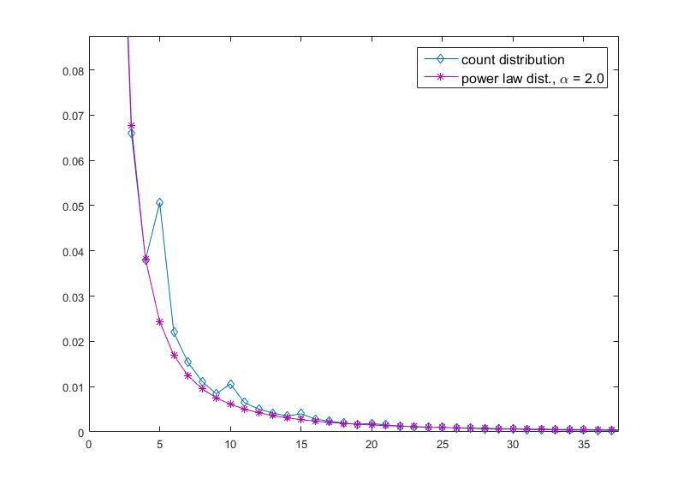
Problem Definition
Goal: predict play counts of the test triplets
Play counts commonly ignored in the literature: implicit feedback
Zero play count: User has not listened to it, or does not like it?
We take the play counts as an explicit feedback; 3 challenges:
Play counts dist. skewed with a very long tail.
Power law dist. With exponent = 2
Cannot use Probabilistic Matrix Factorization
It should be Gaussian
Play counts goes up to 9667.
rating = 1 + ln(count)
Now rating is between 1 to 10
3. Makes the algorithms more complex.

Slide 6

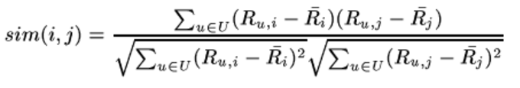
Methods
Collaborative Filtering (CF): makes predictions about the interests of a user by collecting preferences from many users
1. Memory-based: User-based and Song-based.
Pearson correlation:
For every test triplet, we need to calculate the similarity between the test user triplet and every train user triplet (6 Million triplets): Not scalable!!
Only consider those train triplets who have listened to the test song and have at least 10 common songs with the test user.

Slide 7
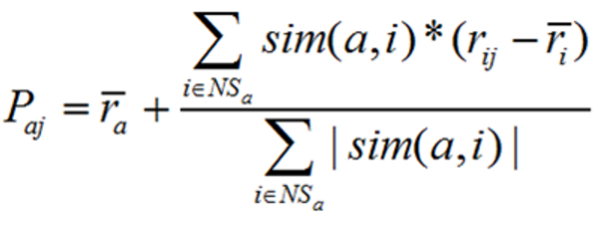
Methods: Memory based
Predicting the rating by
NS_{a} : set of neighbors of user a with respect to song j: users who have listened to song j.
Computes the weighted average of the ratings of the user’s neighbors for the unseen item j, biased by the average rating of user a.
For the song based, above formulas can be equally translated.

Slide 8
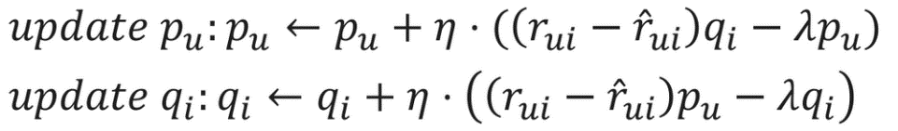
Methods
2. Model-based:
creates profile for each user and each item.
Matrix factorization to discover the latent features.
Applying Gradient Descent:
R_{u,i} size : 1.2 million × 400 thousand : Memory Error

Slide 9
Experiment Design and Evaluation
5-fold cross-validation: Shuffled first, partitioned into training and test with 4:1.
MAE (Mean Average Error) and RMSE (Root Mean Squared Error) as the evaluation metrics.
Memory-based approaches not scalable: Run only on the pruned dataset.
The total running time: 40 hours.
Model-based approach very efficient: seems to scale linearly with # triplets.
For the pruned dataset with 7 million triplets: the total running time 3 hours.
For the whole dataset with 49 million triplets: the total running time 22 hours.

Slide 10
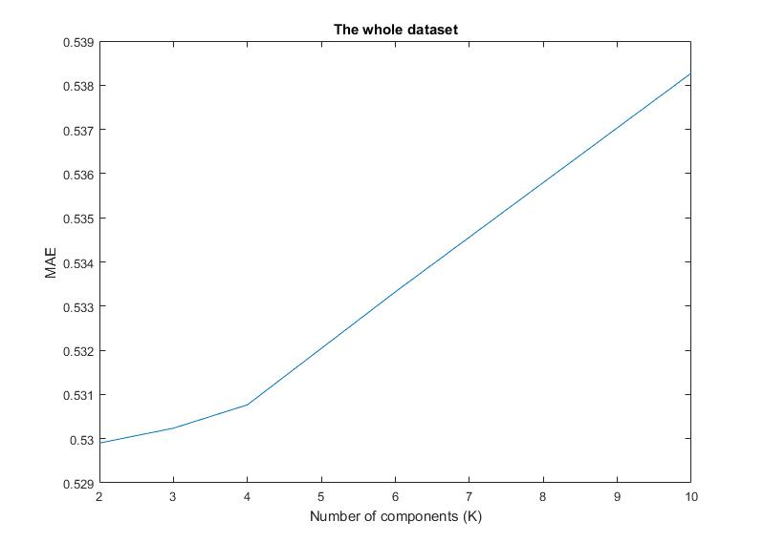
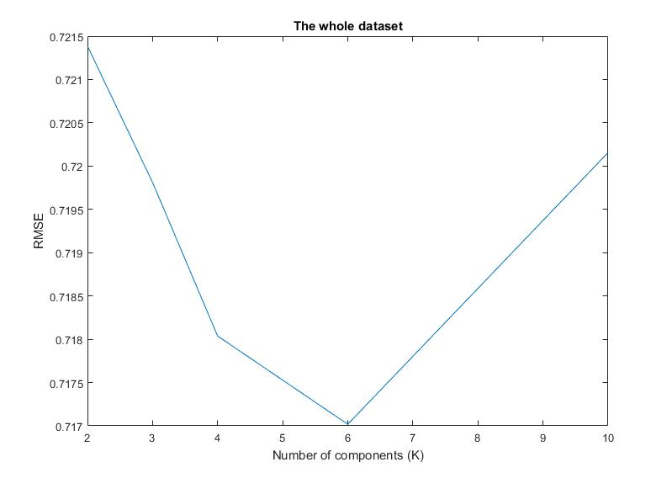
Evaluation: Model-based, whole dataset
MAE, and RMSE vs. number of latent features: K =2 minimizes MAE, k =6 minimizes RMSE

Slide 11
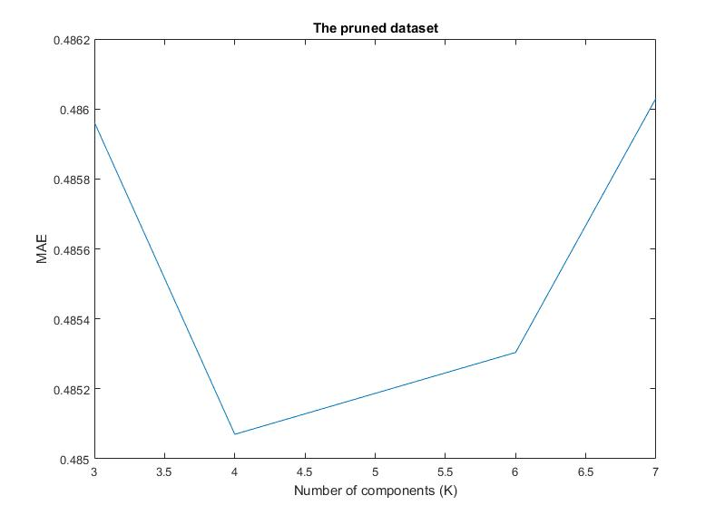
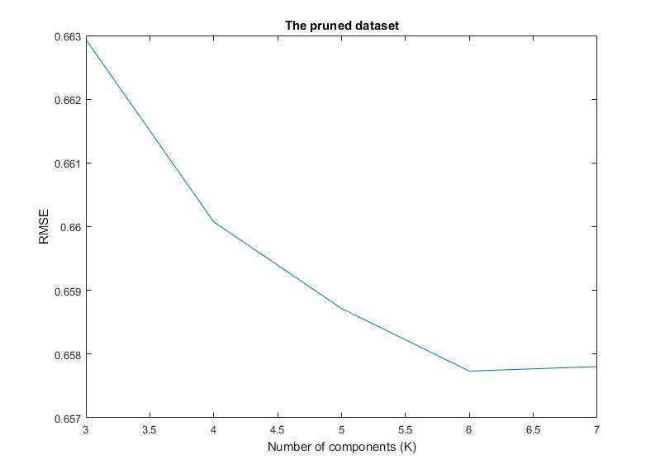
Evaluation: Model-based, pruned dataset
MAE, and RMSE vs. number of latent features: K =4 minimizes MAE, k =6 minimizes RMSE

Slide 12
Observation for Model-based approach results
we need more latent features when data is pruned. Compare k = 2 to k = 4.
Speculation: The richer the dataset becomes the more latent features we can extract from it.
When the dataset is pruned, model’s noise is reduced. Therefore the latent features are more separable. Hence, we need a larger matrix to represent them.

Slide 13
Results Comparison: Pruned dataset
Approach | MAE
Model based (K=4) | 0.485070
User based | 0.487781
Song based | 0.581663
Unlike the results reported in the literature, our user based method had a better performance than the song based.
Speculation: the type of pruning performed in the preprocessing mostly decreases the number of unique users.
Thus, we are cutting off unreliable users, while discarding songs quite randomly.
This type of pruning seems to be rigged against the song based approach.

Slide 14

References
[1] Thierry Bertin-Mahieux, Daniel P.W. Ellis, Brian Whitman, and Paul Lamere, ‘The million song dataset’, in Proceedings of the 12th International Conference on Music Information Retrieval. 2011.
[2] Aiolli, Fabio. "A Preliminary Study on a Recommender System for the Million Songs Dataset Challenge." IIR. 2013.
[3] Van den Oord, Aaron, Sander Dieleman, and Benjamin Schrauwen. "Deep content-based music recommendation." Advances in Neural Information Processing Systems. 2013.
[4] Wang, Xinxi, and Ye Wang. "Improving content-based and hybrid music recommendation using deep learning." Proceedings of the ACM International Conference on Multimedia. 2014.
[5] Ruslan Salakhutdinov and Andriy Mnih. Probabilistic matrix factorization. In Advances in Neural Information Processing Systems, volume 20. 2008.
[6] Yizhou Sun. Recommender Systems. Lecture Slides. http://www.ccs.neu.edu/home/yzsun/classes/2016Spring_CS6220/Slides/09Recommendation.pdf. 2016.
[7] Laerd Statistics. Pearson Product-Moment Correlation.
https://statistics.laerd.com/statistical-guides/pearson-correlation-coefficient-statistical-guide.php

Slide 15

Thank you!

